Slide 1
Introduction to computers and Computer Hardware
Presented by
Syed Shakil Mahmud
Lecturer
Department of Computer Science and Engineering
Bangladesh Army International University of Science and Technology

Slide 2

Introduction to Computer
Major Components of the Computer
Outlines
Basic Architecture of the Computer
Processor
Memory
I/O Devices

Slide 3

What is a Computer?

Slide 4
What is a Computer?
The term computer is derived from the word compute. The word compute means to calculate.
A computer is an electronic machine that accepts data from the user, processes the data by performing calculations and operations on it, and generates the desired output results.
Computer performs both simple and complex operations, with speed and accuracy.

Slide 5
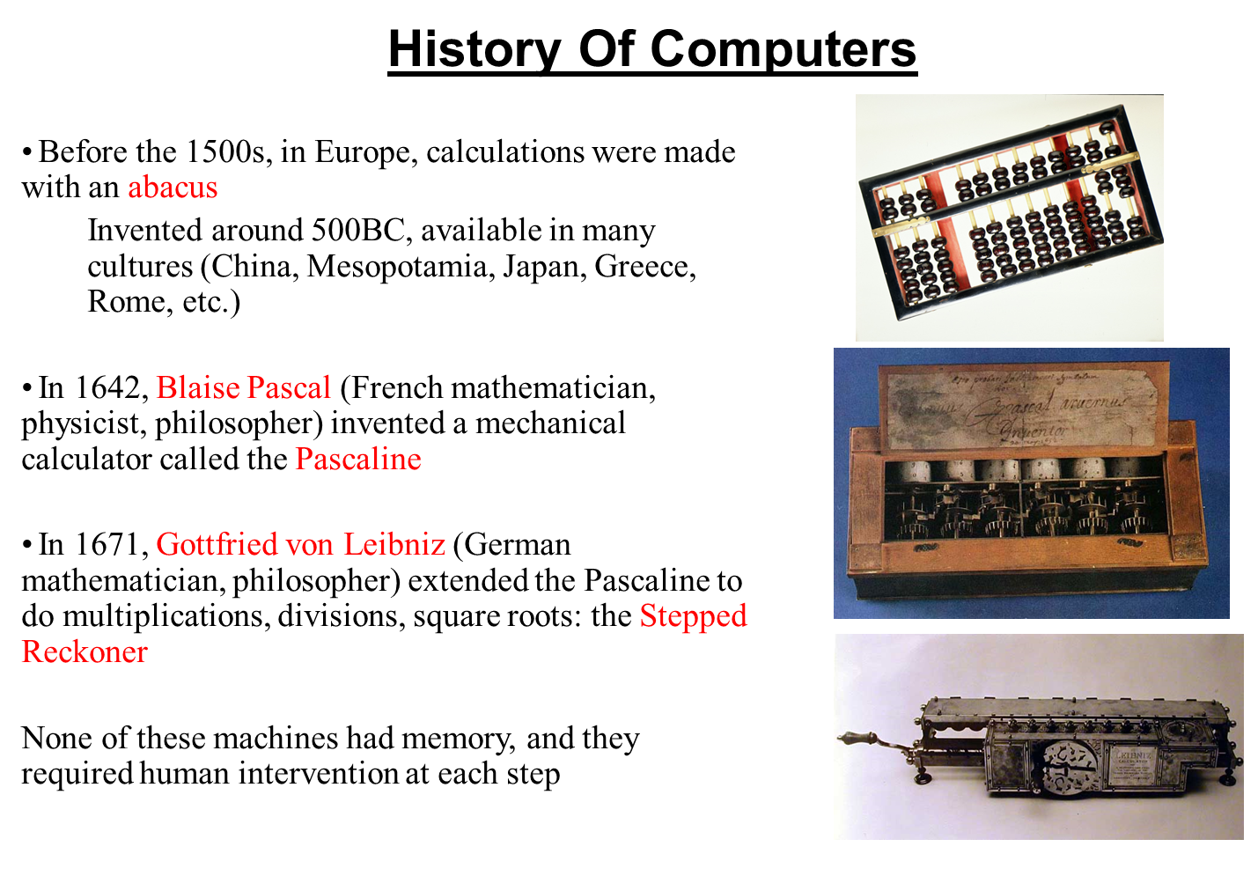

Slide 6
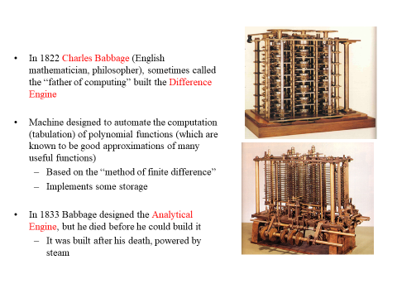

Slide 7
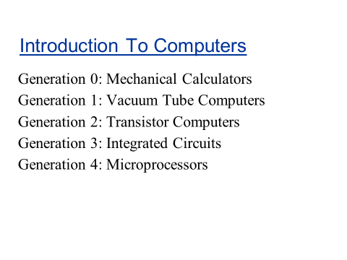
Generations of Computers:

Slide 8
Characteristics Of Computer
Speed: The computer can process data very fast, at the rate of millions of instructions per Second.
Accuracy: The computer provides a high degree of accuracy.
Diligence: When used for a longer period of time, the computer does not get tired or fatigued.
Storage Capability: Large volumes of data and information can be stored in the computer and also retrieved whenever required.
Versatility: Computer is versatile in nature. It can perform different types of tasks with the same ease.

Slide 9
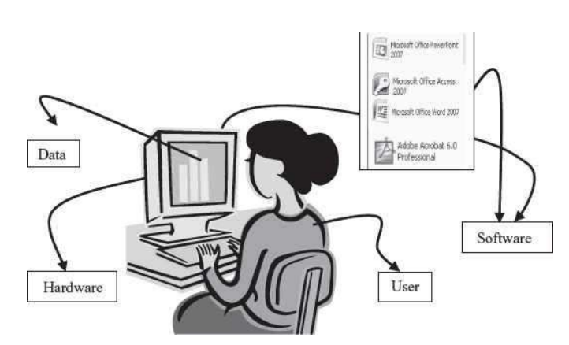
Computer System

Slide 10
Computer System
Computer is an electronic device that accepts data as input, processes the input data by
performing mathematical and logical operations on it, and gives the desired output. The
computer system consists of four parts:
Hardware: consists of the mechanical parts that make up the computer as a machine. The hardware consists of physical devices of the computer.
Software: Software is a set of instructions that tells the computer about the tasks to be performed and how these tasks are to be performed.
Data: Data are isolated values or raw facts, which by themselves have no much significance. For example, the data like 29, January, and 1994 just represent values.
Users: are people who write computer programs or interact with the computer.

Slide 11
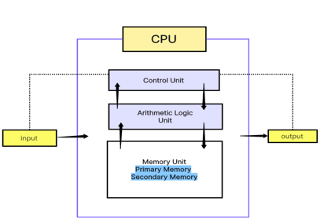
Components of Computer Hardware
The computer system hardware comprises of three main components —
1. Input/Output (I/O) Unit,
2. Central Processing Unit (CPU), and
3. Memory Unit.

Slide 12
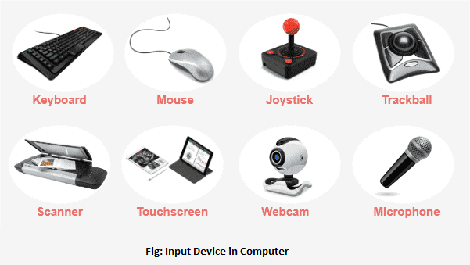
Input Devices
Input devices accept data and instructions from the user or from another computer system.

Slide 13
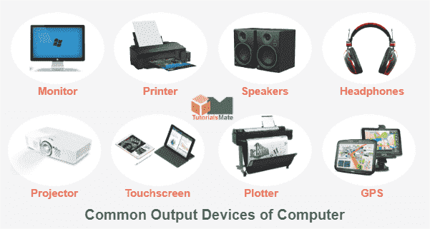
Output Devices
Output devices return processed data to the user or to another computer system.

Slide 14
Central Processing Unit
A Central Processing Unit is also called a processor, central processor, or microprocessor. It carries out all the important functions of a computer.
It receives instructions from both the hardware and active software and produces output accordingly.
It then performs calculations, manipulates data, and produces output based on those instructions.
It stores all important programs like operating systems that manage the computer's resources and allows you to interact with it and application software that you use to perform tasks like word processing, web browsing, and gaming.
It has three parts: Control Unit(CU), Arithmetic and Logic Unit(ALU) and Memory Unit

Slide 15
Central Processing Unit: Control Unit
This unit controls the operations of all parts of the computer but does not carry out any actual data processing operations. The functions of this unit are −
It is responsible for controlling the transfer of data and instructions among other units of a computer.
It manages and coordinates all the units of the computer.
It fetch the instructions from the memory, interprets them, and directs the operation of the computer.
It communicates with Input/Output devices for the transfer of data or results from storage.

Slide 16
Central Processing Unit: Arithmetic and Logic Unit(ALU)
It is the arithmetic logic unit, which carries out arithmetic and logical operations.
Included in the list of arithmetic operations are addition, subtraction, multiplication, division, and comparisons.
Data selection, comparison, and merging are the primary logical operations.

Slide 17
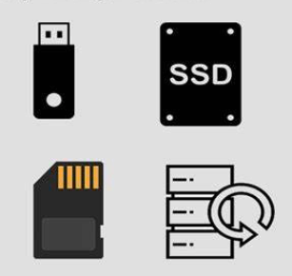
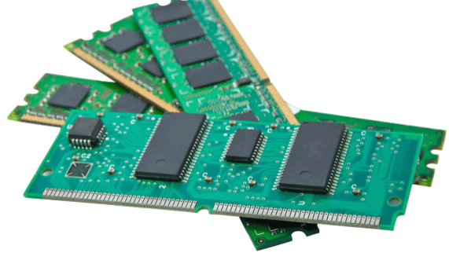
Central Processing Unit: Memory Unit
In a computer, memory is one or more sets of chips that store data and/or program instructions, cither temporarily or permanently.
Personal computers use several different types of memory, but the two most important arc called random access memory(RAM) and read-only memory (ROM).
These two types of memory work in very different ways and perform distinct functions.

Slide 18
Classification Of Computer
Based on data handling capabilities, the computer is of three types:
Analogue Computer
Digital Computer
Hybrid Computer
The digital computers that are available nowadays vary in their size and types. The computers are broadly classified into four categories based on their size and type
Microcomputers,
Mini-computers,
Mainframe computers and
Supercomputer.

Slide 19
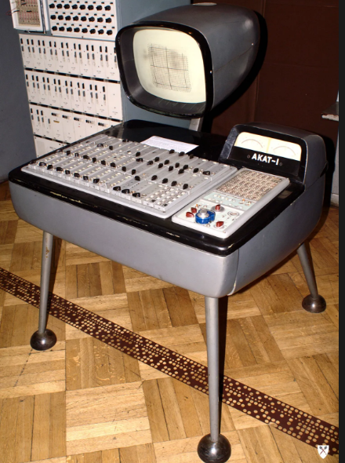
Analog Computers
An Analog computer is another kind of computer that represents data as a variable across a continuous range of values. The earliest computers were analog computers. Analog computers are used for measuring parameters that vary continuously in real-time, such as temperature, pressure and voltage.

Slide 20
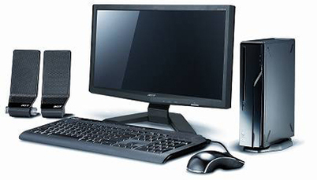
Digital Computers
A digital computer uses distinct values to represent the data internally. All information is represented using the digits Os and 1s. The computers that we use at our homes and offices are digital computers.

Slide 21
Microcomputers
Microcomputers are small, low-cost and single-user digital computer.
They consist of CPU, input unit, output unit, storage unit and the software.
Although microcomputers are stand-alone machines, they can be connected together to create a network of computers that can serve more than one user.
Example: IBM PC based on Pentium microprocessor and Apple Macintosh

Slide 22
Minicomputers
Minicomputers are digital computers, generally used in multi-user systems.
They have high processing speed and high storage capacity than the microcomputers.
Minicomputers can support 4–200 users simultaneously.
The users can access the minicomputer through their PCs or terminal. They are used for real-time applications in industries, research centers, etc.

Slide 23
Mainframe Computers
Mainframe computers are multi-user, multi-programming and high performance computers.
They operate at a very high speed, have very large storage capacity and can handle the workload of many users.
Mainframe computers are large and powerful systems generally used in centralized databases
Used in Software companies.

Slide 24
Supercomputers
Supercomputers are the fastest and the most expensive machines.
They have high processing speed compared to other computers.
Some of the faster supercomputers can perform trillions of calculations per second.
Supercomputers are used for highly calculation-intensive tasks, such as, weather forecasting, climate research (global warming), molecular research, biological research, nuclear research and aircraft design.

Slide 25

Any Questions?

Slide 26
Thank You

